Slide 1

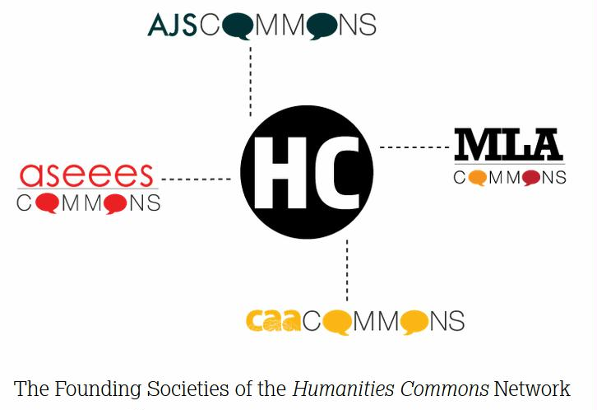

SHARING YOUR SCHOLARSHIP
Through
SOCIAL MEDIA
Rebecca Stuhr & Sarah Wipperman
University of Pennsylvania Libraries

Slide 2
Benefits of Scholarly Sharing Platforms
Pro | Con
Good for dissemination | Fear of lack of rigor
Reaching a broad audience | Gaming the system
Visualization of impact from citations and downloads | Doesn’t measure research but promotional activities such as Facebook and Twitter
Peer recognition | Not a central tool of the discipline
Part of scientific activity | Rewards the outgoing
Demonstrates interest and awareness of research | Time consuming
Scholarly sharing platforms expected to become more important over time | Better to focus on publication in traditional peer-reviewed journals
Notes:
Jamali, Hamid R., David Nicholas, and Eti Herman. “Scholarly Reputation in the Digital Age and the Role of Emerging Platforms and Mechanisms.” Research Evaluation 25.1 (2016): 37–49. Web.
p. 1154 Ideally, participating in informal social media and being active require a lot of effort and time. Thus, informal publishing would be considered a threat to the researchers’ academic career, as it would waste researchers’ time and reduce his or her productivity and research quality:
a large number of participants do not support informal publishing and they think that researchers should focus only on peer-reviewed publications to maintain research quality.
Fundamentally, informal publishing is a way to raise debates, or to disseminate research findings, in a less structured, academic format. In addition, it would help the researcher to target a wider audience.
1157 Informal publishing has potential benefits for researchers if it is used in the rightway. The potential benefits of publishing informally are: getting feedback from a larger community, improving researcher’s skills, a faster medium for publishing and the method’s simplicity and effectiveness:
1158 Participants believe that they have to make information accessible to their readers as not everyone will be able to subscribe to academic databases. Initially, they may do that by sending parts, or all of their work, to other researchers, upload it in academic social networks or share links via Twitter:

Slide 3
Comparing the Options
Community based
Specific Scientific Fields
Submissions posted daily
Moderated by approved subject specialists
Free to authors
Free to users
Notes:
The grandparent of collaborative sites, ArXiv started in 1991, now hosted and funded by Cornell University with support from member institutions. arXiv supplements the traditional publication system by providing immediate dissemination and open access to scholarly articles (which often later appear in conventional journals). Covered areas include physics, mathematics, computer science, nonlinear sciences, quantitative biology and statistics

Slide 4
Comparing the Options
Notes:
A growing field of collaborative scholarly sites, offering prepublication submission, opportunity for commentary, peer review, dissemination, and broad sharing across scholarly communities and openly accessible to the public.
18th Century Connect – peer review, visualization of texts, access to the plain text of documents from EEBO and ECCO, crowd-sourced correction
DH Commons – site for finding and building on collaborations, peer review of in process projects
Programming Historian – An online journal (with ISSN) providing peer reviewed lessons for humanists on using digital tools and workflows, contributors work with the Project Team and Peer Reviewers as they propose and develop lessons. “Application Programming Interfaces (APIs), Data Management, Data Manipulation, Distant Reading, Mapping and Geographic Information Systems (GIS), Network Analysis, Digital Exhibit Building, Programming, and Web Scraping, and more. Our tutorials include nearly a dozen lessons on popular DH tools such as MALLET, Omeka, and QGIS”
bioRxiv-built on the model of arXiv, a free online archive and distribution service for unpublished preprints in the life sciences. It is operated by Cold Spring Harbor Laboratory, a not-for-profit research and educational institution. By posting preprints on bioRxiv, authors are able to make their findings immediately available to the scientific community and receive feedback on draft manuscripts before they are submitted to journals.
The Conversation-a collaboration between editors and academics to provide informed news analysis and commentary that’s free to read and republish. We are committed to knowledge-based, ethical and responsible journalism. Writers must be experts in the field in which they write and their qualifications are posted alongside their articles along with any potential conflicts of interest. You can republish articles from the Conversaton for free using a Creative Commons license. There is no paywal, and the Conversation is a not-for-profit organization serving the public good.
MLACommons CORE- is in Beta and is intended as a pre and post publication site for trying out ideas, soliciting commentary, to share and showcase research, to “assert authorship” on unpublished work such as conference presentations, syllabi, datasets, etc. CORE is openly accessible and does not require MLA membership to view, but you do need to be a member to submit.
NINES—developed to provide peer review for digital resources and archives created by scholars in nineteenth-century studies. It has also developed software to further digitally based research including Juxta which provides a means of comparing editions of texts, Collex, an exhibiting tool, and Ivanhoe, a gaming approach to analyzing text.

Slide 5
Comparing the Options
Academia .edu | ResearchGate.net
Collegial networking | Collegial networking
Interdisciplinary | Interdisciplinary
Follow individuals and topics | Follow individuals and topics
Do it yourself Permissions Upload Format Citations | Do it yourself Permissions Upload Format Citations
Metrics | Searches Web for full text versions of your documents
Analytics | Metrics-Analytics
Discoverability among peers | Discoverability among peers
For Profit Earnings from ads and job postings | For Profit Earnings from ads and job postings

Slide 6
Penn Departments Represented
Academia.edu | ResearchGate.net

Slide 7
Acdemia.edu Departmental Page
ResearchGate
Departmental Page

Slide 8
Individual page in Academia.edu

Slide 9
Individual page and metrics in
ResearchGatae
https://www.researchgate.net/profile/Christopher_Murray5/stats

Slide 10
UPLOAD FULL TEXT: FACILITATED BY
RESEARCHGATE
[Including full text in ScholarlyCommons]

Slide 11
Elsevier Solicits Take Downs

Slide 12
Copyright and ResearchGate
We respect the intellectual property rights of others and ask that you do so as well.
Our platform enables the private archiving and public posting of various types of content.
When you post content, we must insist that you archive or publish content only if you have the right to do so. This applies to both your own profile as well as other places on the platform, such as Q&A and projects. As we do not have any information about rights you may hold, or any license terms or other restrictions which
might apply to such content, we necessarily rely on you to understand your
rights and act accordingly. For this reason, we request that you fully investigate and confirm that you have sufficient rights to post particular content to ResearchGate before you post such content. As a general matter, if you are an author publishing in a journal, you may be allowed to publish certain versions of your article, but not others, and privately share certain content with others. However, many journals restrict publication of final versions and impose limitations on private sharing.
Your starting point for understanding your rights is the agreement(s) you have with your publisher or other rights owner. There are other resources available that you might also find useful in understanding your rights including:

Slide 13
Copyright and Academia.edu
It is Academia.edu’s policy, in appropriate circumstances and at its discretion, to disable and/or terminate the accounts of users who repeatedly infringe or are repeatedly charged with infringing the copyrights or other intellectual property rights of others.
In accordance with the Digital Millennium Copyright Act of 1998 . . . Academia.edu will respond expeditiously to claims of copyright infringement committed using the Academia.edu website . . ..
…
Do I own my work or article? Do I have the right to post my work or article . ..
. . . The general rule is that the person who creates a work is the author and owner of the work. However, there are exceptions to that rule. . . publishers frequently require authors to transfer their copyrights to the publishers as a condition of publication. The transfer of ownership of a copyright to a publisher will prevent the author from future use of the work unless the author has agreed with the publisher that he or she reserves his or her right to use the work for certain purposes, such as teaching, research or other non-profit educational activities, or for certain types of use, such as rights to post an electronic version of the work on the faculty member’s website or on websites like Academia.edu.

Slide 14
Comparing the Options
ScholarlyCommon
Penn’s Institutional Repository
    Assistance with permissions
    Assistance with loading and formatting
    Permanent URLs
    Multimedia
    Widely discoverable through Google
    Institutional Commitment for long term availability
    Analytics / metrics

Slide 15
DigitalCommons
Penn’s publications are part of a larger “Commons” database

Slide 16
Metrics
Personal
metrics

Slide 17
Exploring Disciplinary Research in Scholarly Commons Through the Color Wheel

Slide 18
Narrow Your Results

Slide 19
Read

Slide 20
Find on Google

Slide 21
How do you want to present yourself online?
Academia.edu, ResearchGate, SSRN
  For profit organizations; individually focused conversation about your work; peer to peer
arXiv, bioRxiv, MLA Commons Core, Nines, 18th Century Connect, Programming Historians, and others
  Built by scholars for scholars; peer review and commentary, works in progress; professional support
ScholarlyCommons
  Long term archive of scholarship at Penn; Metrics; broad dissemination to wider public audience
Link these together

Slide 22
Sharing Workflow
Work with Scholarly Commons Staff to determine permissions status and create site
Develop site at your choice of scholarly sharing platform
Link back to ScholarlyCommons to upload cleared documents
Follow topics and scholars at each site

