Slide 1
PRIO’s mission is to conduct research for a more peaceful world. To fulfil this purpose PRIO attracts and nurtures academic excellence, makes research-based insights accessible to a broad audience, informs decision-making, and works with relevant partners worldwide
December 2013

Slide 2
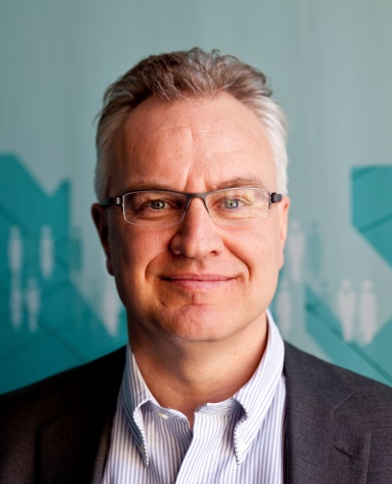
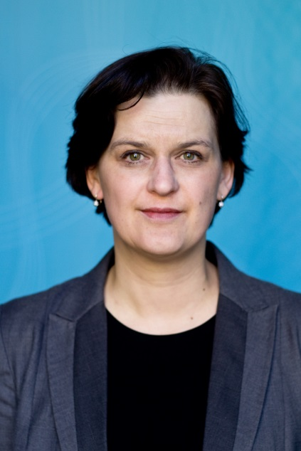
PRIO
Non-profit research institute founded in 1959
Independent foundation, headquartered in Oslo
International, multi-disciplinary staff of about 100
Project based financing, major funders include national research councils, ministries, international organizations, and private endowments
Nurtures international partnerships, on project basis as well as with the programme for PRIO Global Fellows, the Peace Research Endowment (New York), and our branch office in Nicosia, the PRIO Cyprus Centre
Communicates and engages with various communities, such as international academic networks, multilateral organizations, governmental agencies and civil society actors
Turnover 2013:100 million NOK (USD 17 million)
Kristian Berg
Harpviken
Inger Skjelsbæk
Director
Deputy Director

Slide 3
What does PRIO deliver?
Basis for knowledge
  Thematic focus
  Country/area knowledge
  Quantitative analysis and data hub for scholars globally
Policy advice
Engages actively in teaching and training, including the hosting of a research school in Peace and Conflict for PhD scholars in collaboration with Norwegian partners
Dialogue and fostering of relationships
Publishes findings in major international journals and with the leading publishing houses
Journals at PRIO
  Journal of Peace Research
  Security Dialogue
  Journal of Military Ethics
  International Area Studies Review

Slide 4
Organization
Director’s Office
Administration
Communication
Social Dynamics
Dimensions
of Security
Conditions of
Violence and Peace
PRIO Cyprus Centre
Projects administered by a specific Department
Cross-cutting thematic Research Groups

Slide 5















Research groups

Slide 6
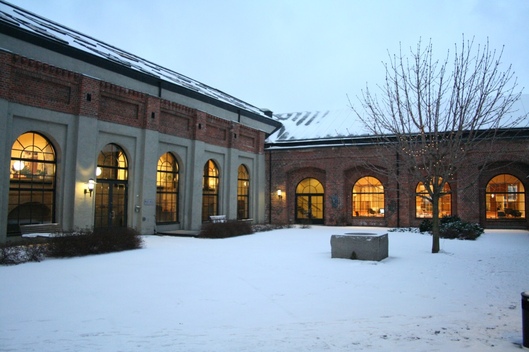
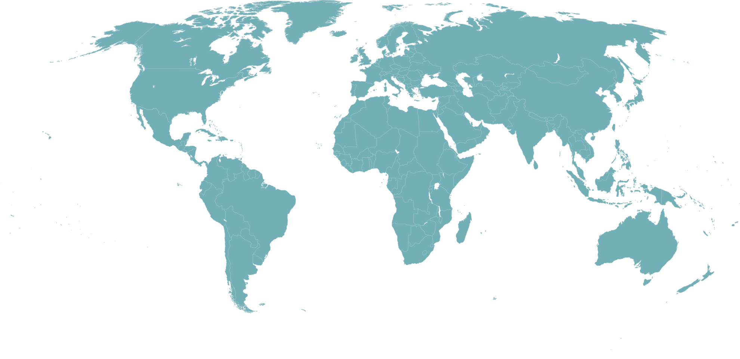
www.prio.org

