Slide 1

Ecologic Institute
Science and Policy
for a Sustainable World
Berlin – Brussels
Washington DC – San Mateo CA
Ecologic.eu
EIUS.org

Slide 2

Our Vision
Science and Policy for a
Sustainable World
Address the Socio-Political Challenges of
Sustainability Research
Bring New Insights into Environmental Policy

Slide 3
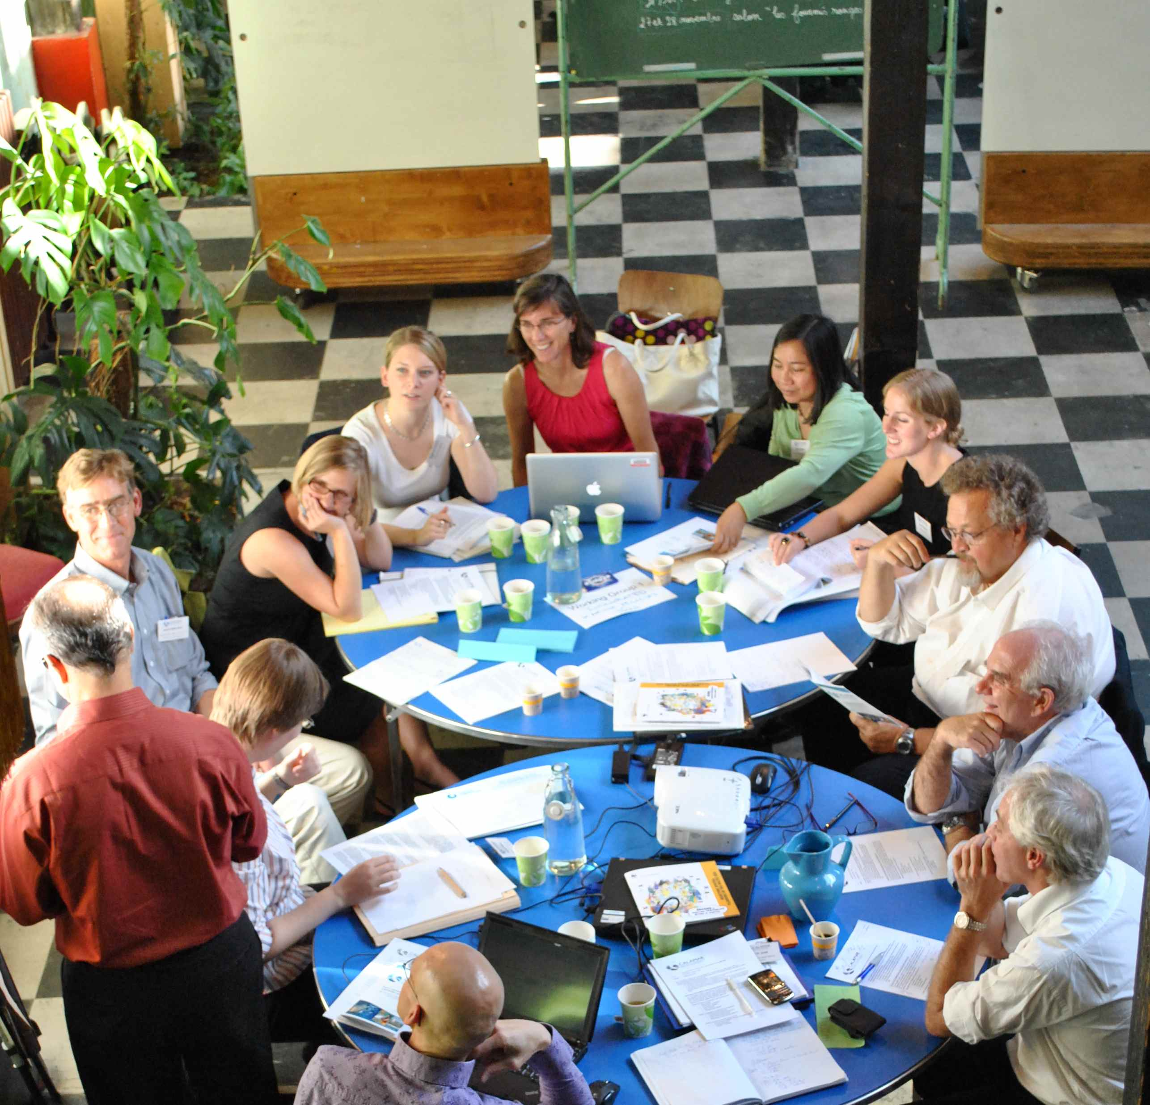
Our Mission
Scientific Excellence AND
Political & Societal Relevance
Policy Analysis
Consultancy
Environmental Research
International
Transdisciplinary Teams
Notes:
Aus: mission statement neu

Slide 4
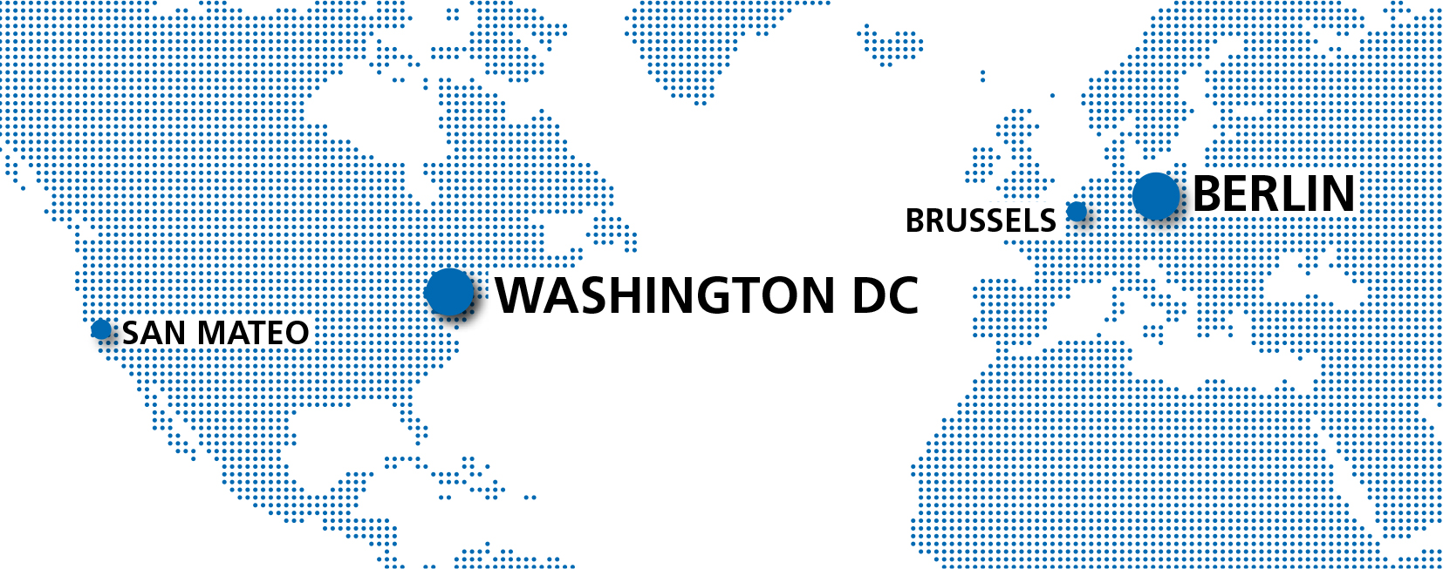
Our Geographical Scope
Founded 2008
Founded 1995

Slide 5

Our Main Research Focus
Societal Transformations towards a Sustainable Community
Acceptance & Governance of Transformation Processes
Effects of Measures on Environmental Status
Consumption of
Natural Resources

Slide 6

Transdisciplinarity as a Modus
Innovative Methods
& their Combinations
Integration of Knowledge
& Different Scientific Disciplines
Elaboration of Solutions in Partnership with Practitioners

Slide 7
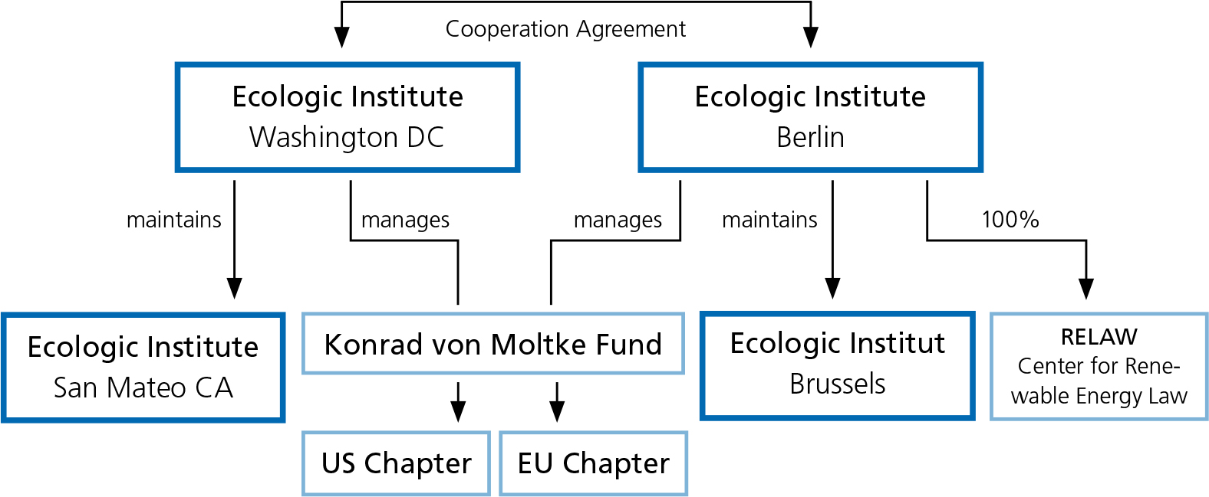
Structure of the Ecologic Institutes
Private, Independent, Non-Profit

Slide 8

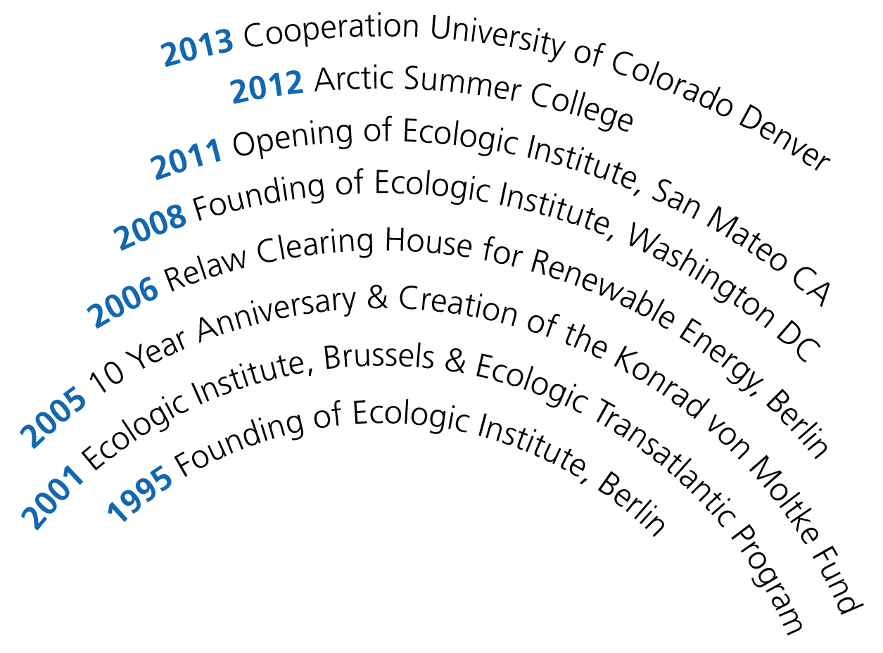
Our History

Slide 9

Our Partnerships
Network of Institutes for European Environmental Policy (IEEP)
Ecological Research Network (Ecornet.eu)
Teaching:
    Duke University, Durham, NC
    University of Colorado Denver, CO
    Eberswalde University for Sustainable Development (HNEE)

Slide 10
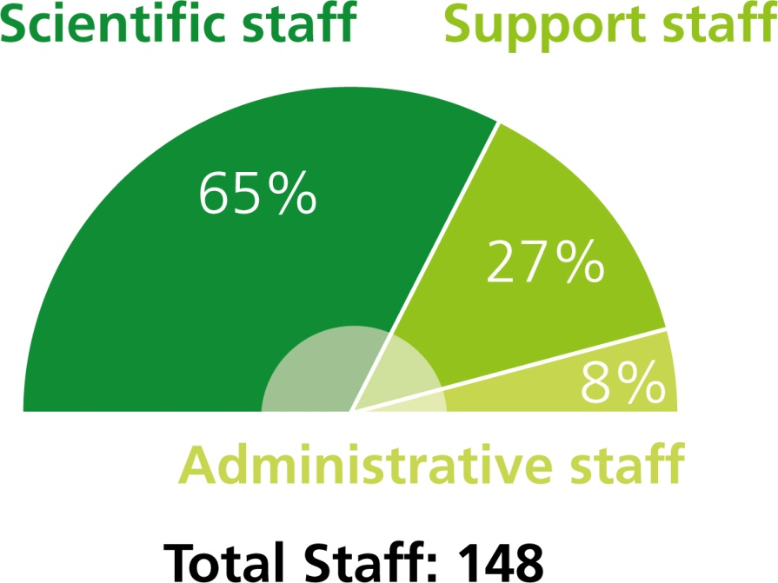
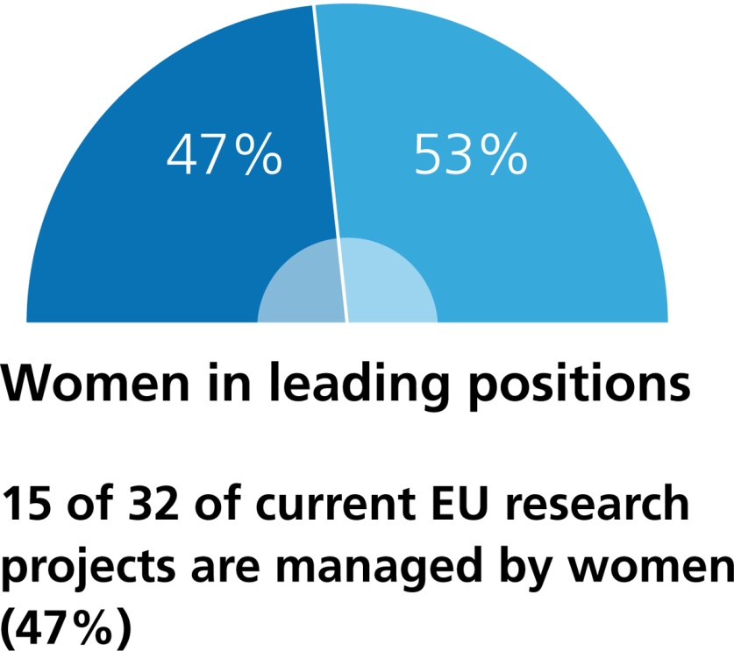
Our Staff 2013

Slide 11
Revenue Composition 2012

Slide 12
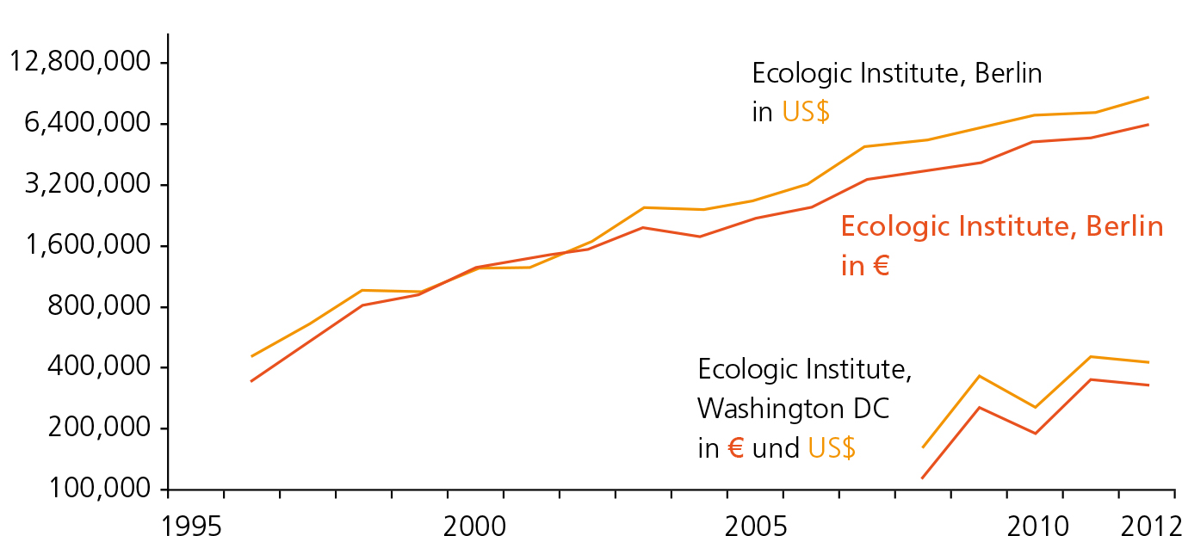
Our Value of Projects 1995 – 2012
In 2013: more than 100 Research Projects

Slide 13

Our Main Performance Indicators
Research
Output
Network Embeddedness
Public
Policy
Publications
Teaching
Formal Accreditation
Study Reports
Citations
Lectures
Funders & Sponsors
Project Partners
Issue Networks
Alumni
Legislation
Adopted Policies
Report by Parliament
Report by Government
Official Appointments
Notes:
Mindmap RAK Performance Indicators

Slide 14

Our Major Programs
Biodiversity
Public Diplomacy
Marine Policy
Waste
Bioenergy
Arctic
Water
Security Policy
Cities
Resources
Energy
Nature Conservation
Trade
Climate
Consumer Policy
Adaptation
Soil
Agriculture
Democracy
Environment
Health
Sustainability
Foreign Policy
Transport
Governance
Industry
Development
Forest
International Environmental Law
Land Use
Notes:
Aus Website

Slide 15
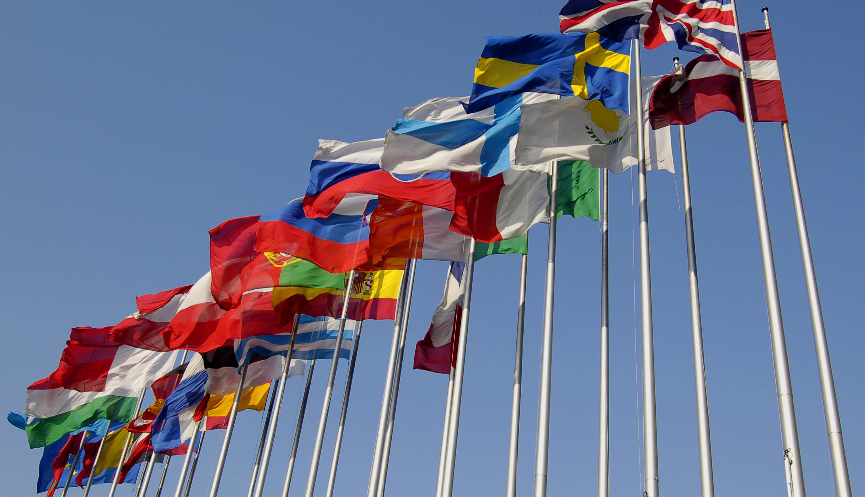
EU Research Projects with Ecologic Institute in the Lead
POCACITO
NETGREEN
EFFACE
DYNAMIX
CECILIA 2050
Post-Carbon Cities in Europe
2014-16
NETwork for GREEN Economy Indicators
2013-16
EU Action
to Fight Environmental Crime
2012-16
Dynamic Policy Mixes for Absolute Decoupling of Environmental Impact of EU Resource Use from Economic Growth
2012-15
Combining Policy Instruments to Achieve Europe's
2050 Climate Targets
2012-15
Current European Research Projects:
32
ecologic.eu/eu-research

Slide 16
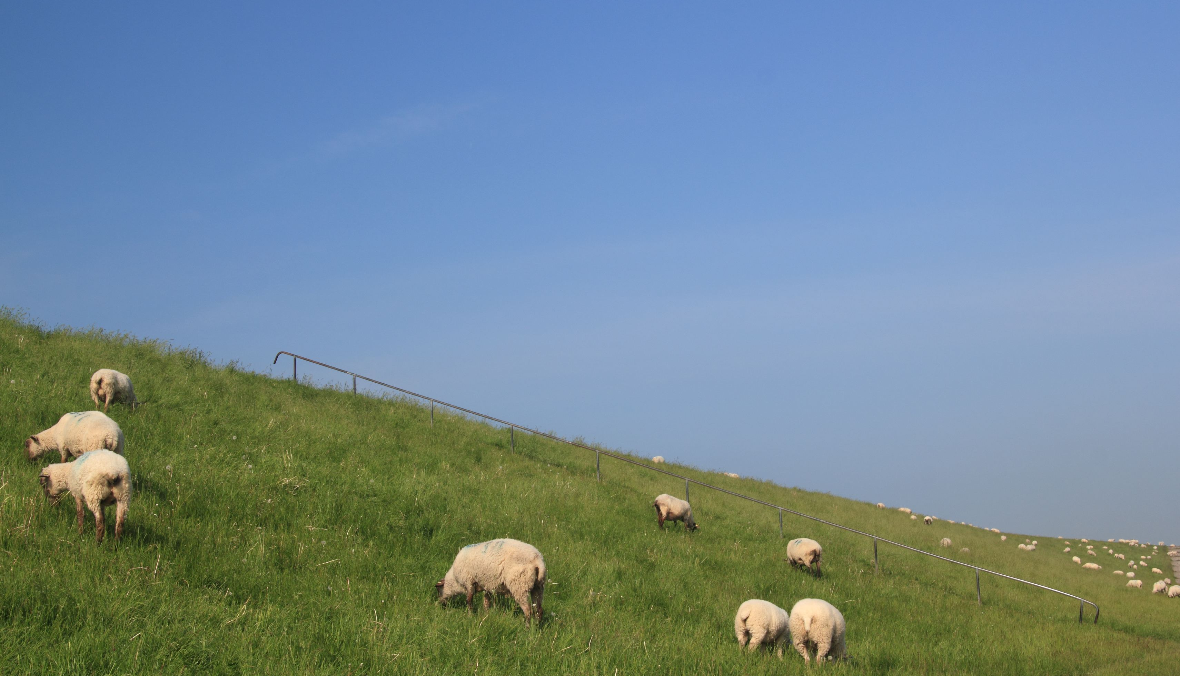
One of Our National Research Projects: RADOST
RADOST
Component of the Initiative KLIMZUG
Climate Change in Regions
Funded by the German Ministry for Education & Research
(BMBF)
Development of Adaptation Strategies
for the German Baltic Coastline
Regional Adaptation Strategies in the German Baltic Sea Coast
2009-14
Cooperation with
Local Partners –
Dialogue among Academics, Economists, Policy Makers,
and the Public
Core Team of 18 Partners
klimzug-radost.de
Notes:
Aus RADOST

Slide 17

Our Role and Impact in Policy Research
Our Role
Our Impact
We Present
Arguments & Solutions for Integrating Environmental Protection Requirements into other Policies
We Provide Neutral Platforms for
Better-Informed Policy Debate
& Decision Making
Notes:
Aus RAK Beitrag Chapter 3, p. 11 + 14
Our Role
Our Impact

Slide 18
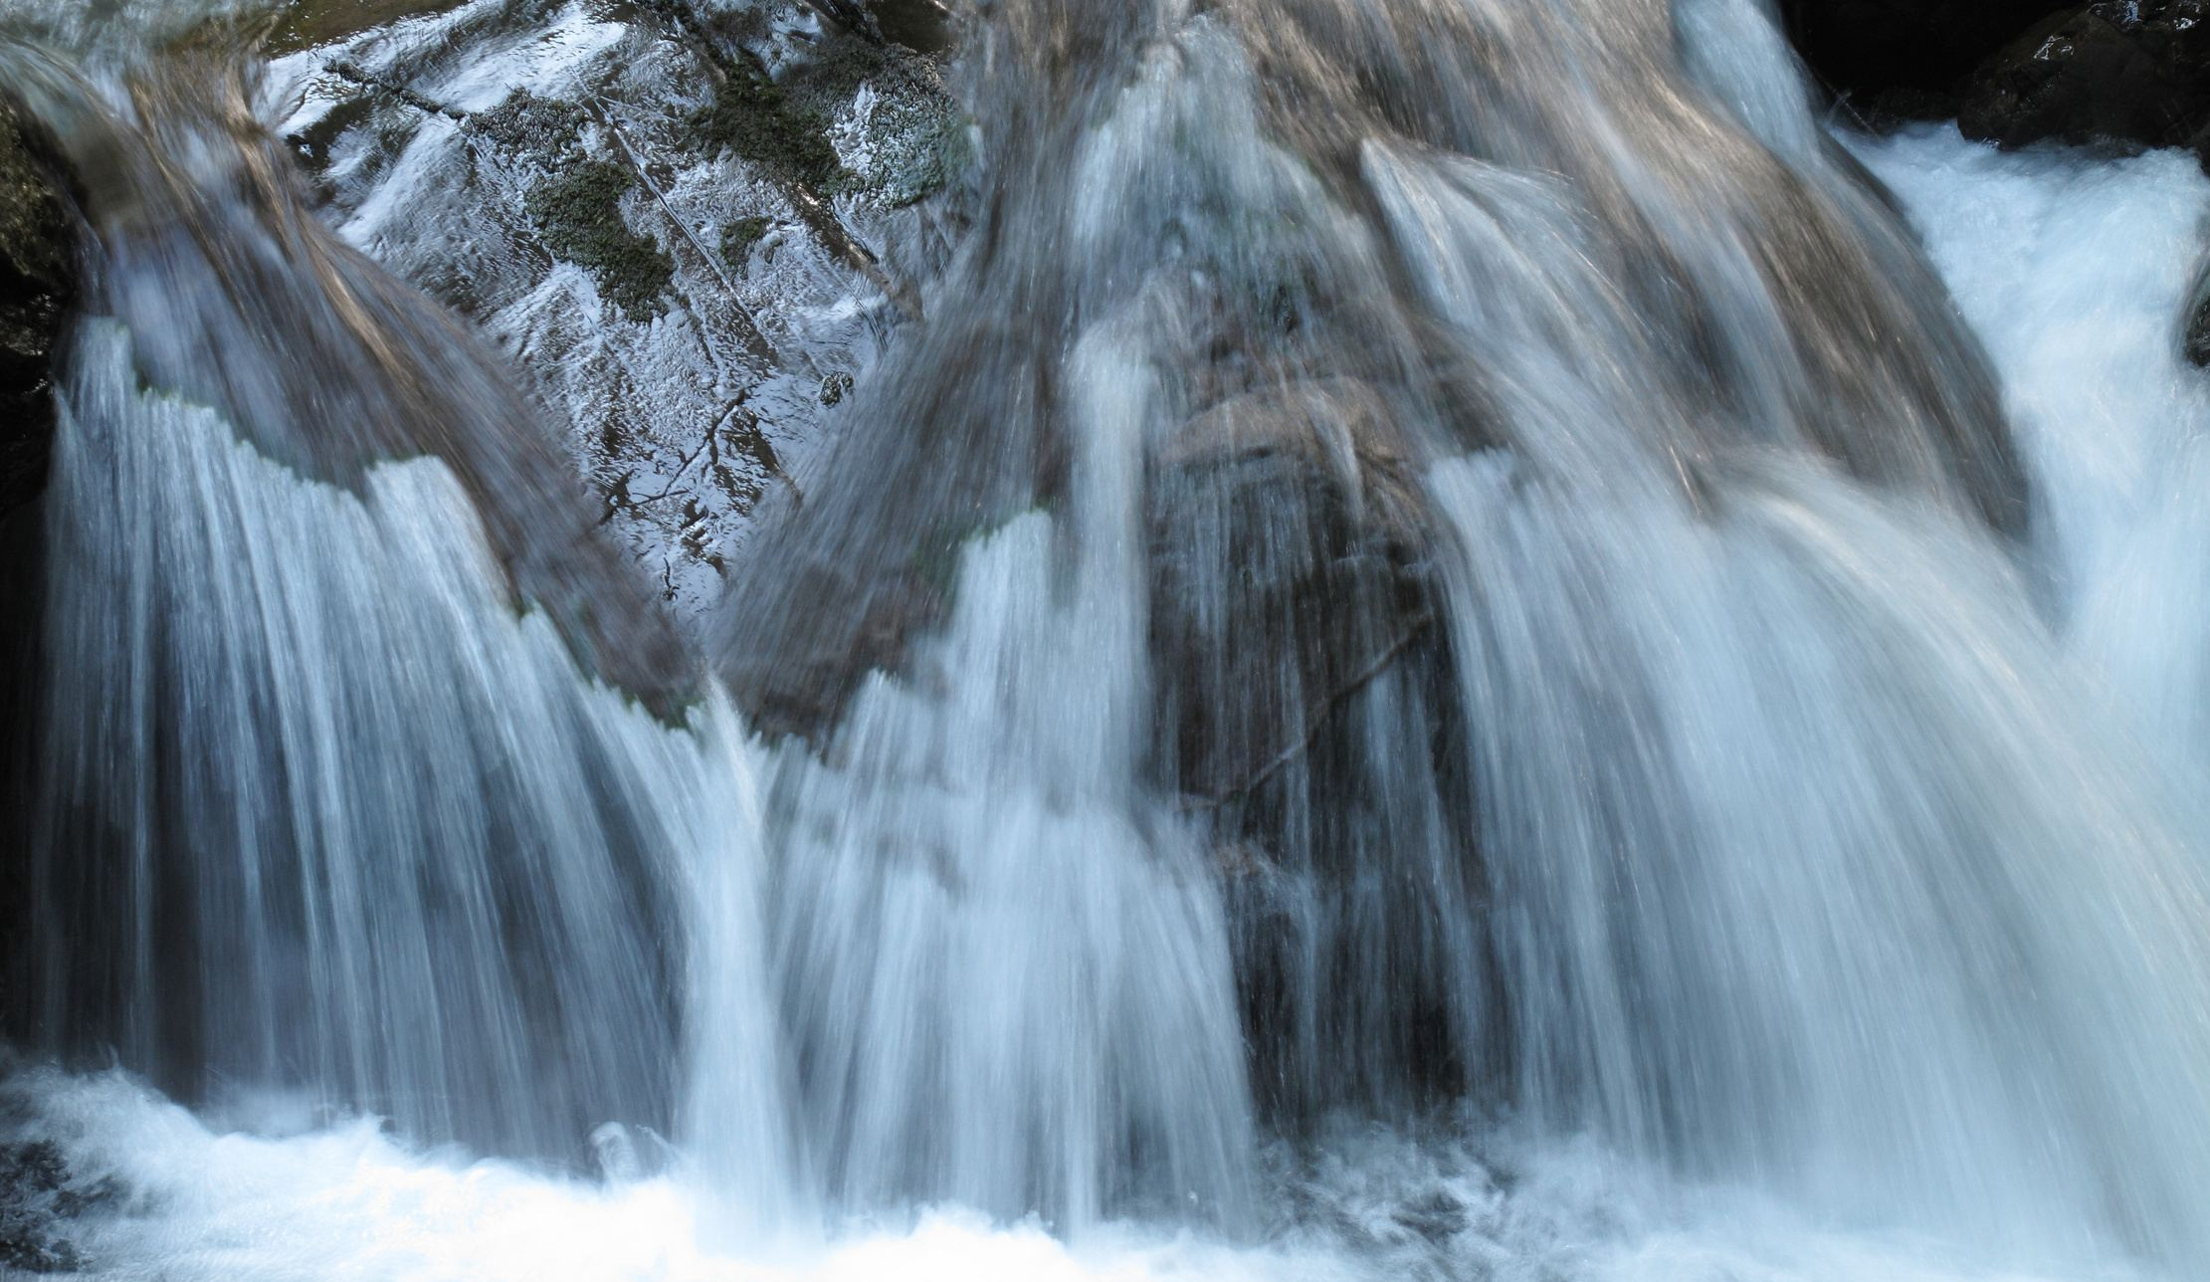
One Success Story: Water Policy
Alignment of Regulatory Approaches
Across EU Member States
Ecologic Institute Built the Basis of
EU Agreement on the “Combined Approach”
in the Regulation of Water Uses
that has Become a Cornerstone of the
EU Water Framework Directive
Notes:
Aus RAK Beitrag Chapter 3, p. 13
- Link zur Website? Projektnummer?

Slide 19

One Success Story: Energy Policy
Green Power Shift
in Germany and in the EU
  Ecologic Institute Contributed to the
  Green Power Shift in Germany by
  Providing Expertise and Advice
  on the Development of the Legal Framework for the Energy Sector, and Especially the Evolution of the
  Renewable Energy Sources Act (EEG)
Notes:
Aus RAK Beitrag Chapter 3, p. 13/14
- Link zur Website? Projektnummer?

Slide 20
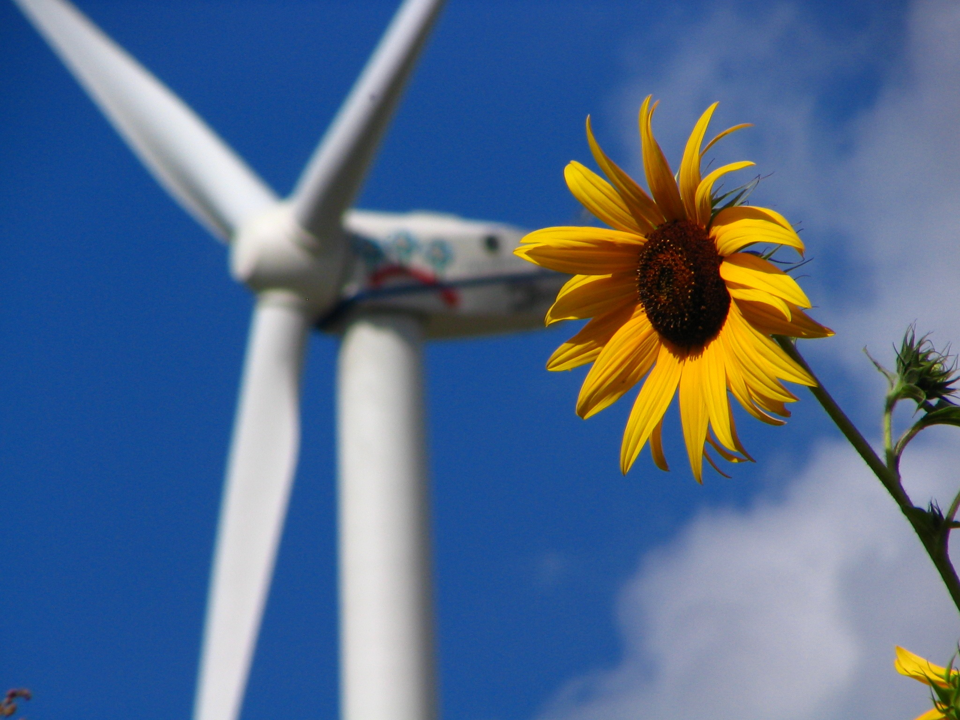
One Success Story: Clearing Point
Clearingstelle EEG
Ecologic Institute Established and Maintains an
Alternative Dispute Resolution Mechanism
for Independant Renewable Power Producer and
Grid Operators
clearingstelle-eeg.de/english
Notes:
Aus RAK Beitrag Chapter 3, p. 8

Slide 21

One Success Story: Thinking Beyond GDP
Greening the Economy
Ecologic Institute Developed Recommendations for Indicators that Integrate the Measurement of Progress in Economic Success, Human Well-being, Environmental Protection, and
Long-term Sustainability
in-stream.eu
netgreen-project.eu

Slide 22

Thank You!
Ecologic.eu
EIUS.org
Ecologic Institute
Science and Policy
for a Sustainable World
Notes:
Mehr Projektbeispiele (Nationaler Allocationsplan, Beyond GDP, Emissionshandel, …)?
Deutsche Version erstellen
Regelmäßige Aktualisierung
Intranet
Ecologic for Beginners

