Slide 1
Researching the public domain, open access, and copyright
What you need to know to get started
John Mark Ockerbloom
Robert Terrell
University of Pennsylvania Open Access Week
October 22, 2015

Slide 2
Why can’t we copy and distribute whatever we want?
Copyright
Contract
Misappropriation
Trademark
Defamation
Patent

Slide 3
Copyright Basics
Copyright protects the form of expression, not ideas or facts.
Subject matter:
Literary works
Musical works
Dramatic works
Pantomimes and choreographic works
Pictorial, graphic and sculptural works
Motion pictures and other audiovisual works
Sound recordings
Architectural works

Slide 4
What is copyrighted?
Requirements
Original authorship
not copied
capable of being expressed in a number of ways
minimal creativity
Fixed in a tangible medium of expression

Slide 5
Copyright owner’s exclusive rights
Reproduce the copyrighted work
Adapt (make derivative works)
Distribute copies
Publicly perform
Publicly display
Publicly perform sound recordings by digital
audio transmission

Slide 6
Current Terms of Protection
Works of individuals
Life of author(s) + 70 years (works created after 1977)
Corporate works
Shorter of 120 years from creation or 95 years from publication
But there are lots of special rules and exceptions
(and older works tend to have different terms)

Slide 7
When can you copy and reuse expressive work?
When it’s in the public domain
  Not just really old material, as we’ll see
  But make sure you’re not under contract restriction
When you own the rights to the material
When it’s available under an open license
  (but check details of what license allows)
When you’ve obtained permission for your use
When the law specifically allows your use
When your use is “fair use”
  A judgment call based on 4 specific factors

Slide 8
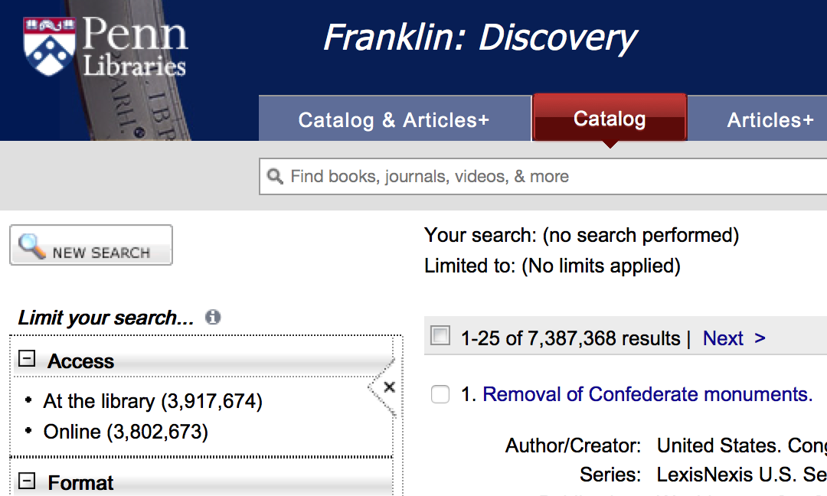
Find millions of public domain works

Slide 9
When is a work now in public domain?
When the copyright was secured before 1923
When a work did not meet required formalities
  Unrenewed copyrights prior to 1964
  Publications without © notice prior to 1989
  BUT: Many non-US works exempt from formalities
When it was created by the federal government (& sometimes other governments)
When it was not published by 2003, and would not be copyrighted under current terms
(Any one of the above suffices)

Slide 10
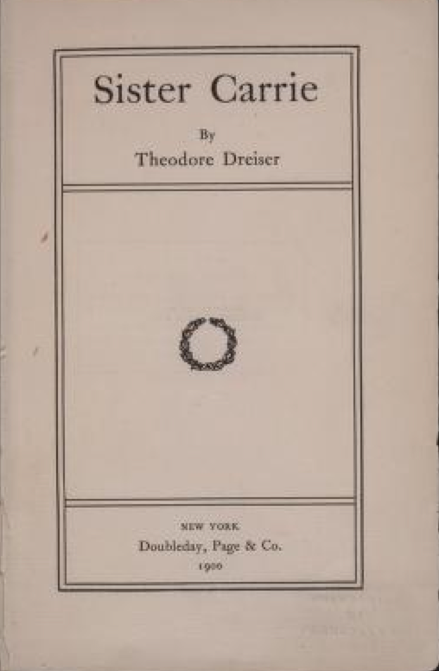
Copyrights secured before 1923 have expired
Generally speaking, this covers anything published before 1923
Some post-1923 publications might only have pre-1923 copyrights
  Check copyright notice

Slide 11
Works with unrenewed copyrights
Copyrights prior to 1978 came up for renewal in their 28th year
If no one renewed pre-1964 copyrights, they expired (exception: exempt foreign works)
If no one renewed 1964-1977 copyrights, they automatically renewed on behalf of the author(s), or their heirs
Post-1977 copyrights: single term (no renewal)
More details:
  http://copyright.gov/circs/circ15.pdf

Slide 12
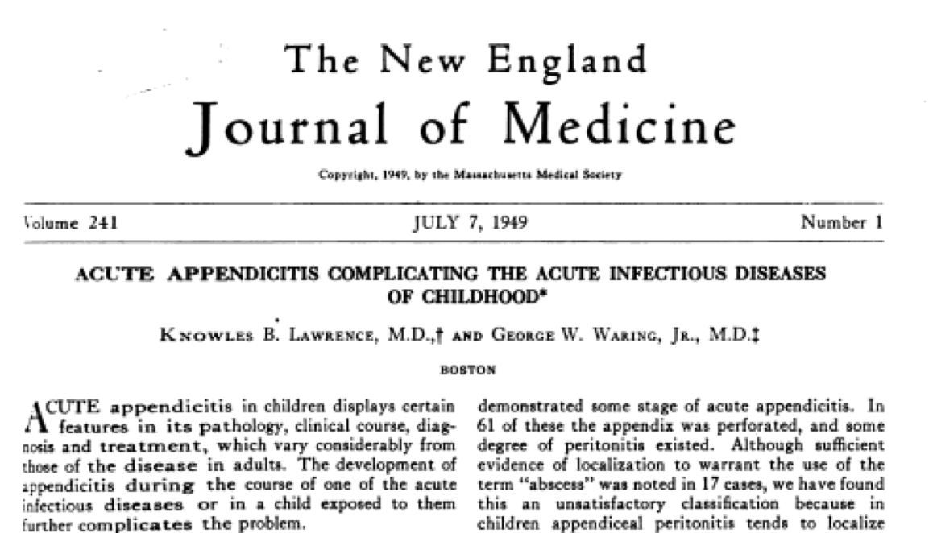
Unrenewed: Many books, nearly all published images, most articles…

Slide 13
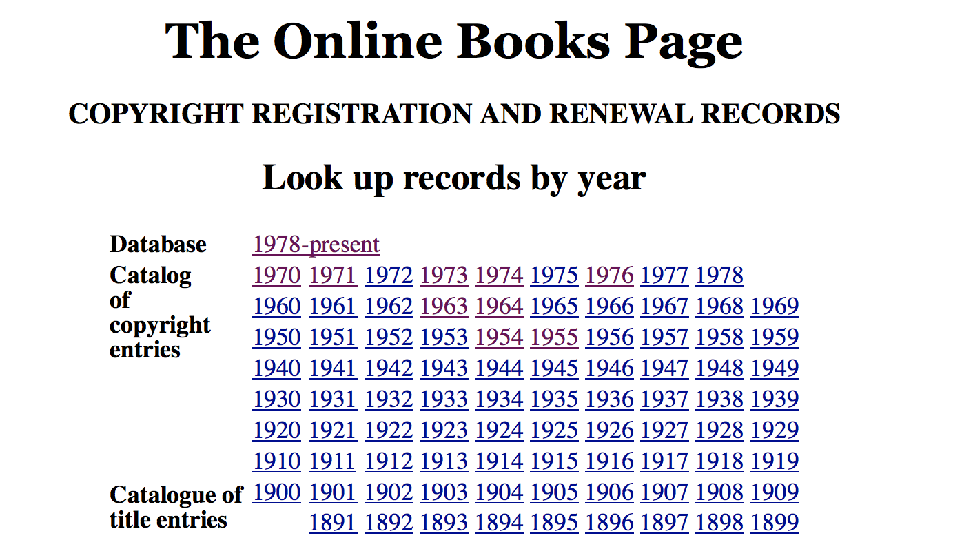
How to research copyright renewals
http://onlinebooks.library.upenn.edu/cce/

Slide 14
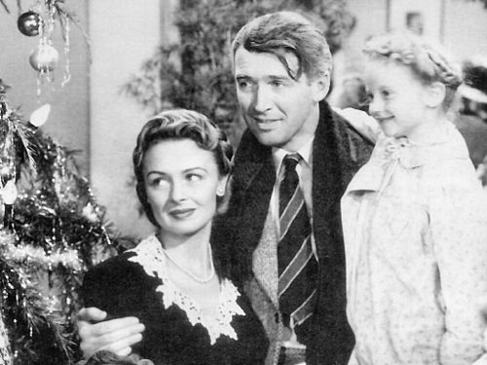
Caveat: Works that include or derive from works still in copyright

Slide 15
Works without copyright notices
Before March 1989, publications had to have a notice to be copyrighted (exception: exempt foreign works)
Notice: “Copyright” (or “Copr.” or “©”), year, claimant (e.g. “© 2015 John Mark Ockerbloom”)
(Note: From 1978 to 1989, inadvertent omissions could be corrected in a certain time interval)
More info:
  http://www.copyright.gov/circs/circ03.pdf

Slide 16
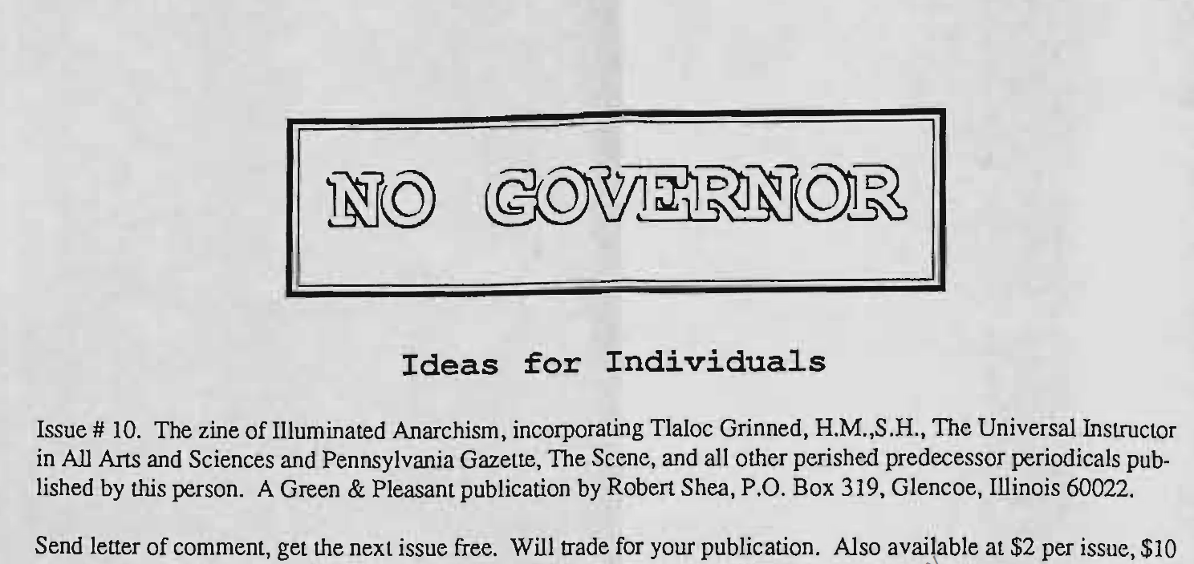
Without notice: Many pamphlets, “gray literature”, ephemera…

Slide 17
Caveat: Many works created abroad exempt from formalities
1990s trade agreement returned them to ©!
Exemption conditions (all must be true):
  Author citizen or resident of other country
  Work was still in copyright in “home” country at time agreement went into force (usually 1996)
  Work first published there, & not in US for at least 30 days afterwards (but distribution counts)
Exempt works get full term as if published with normal notice, registration, renewal….

Slide 18
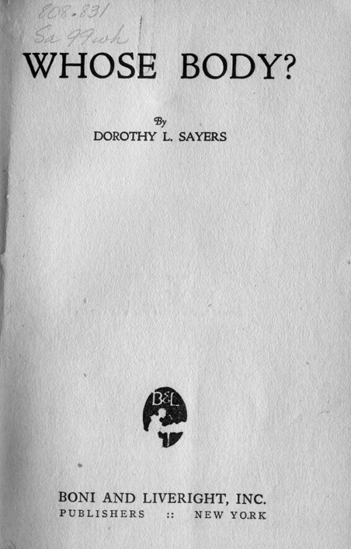
Some foreign works were published here in time to avoid exemption

Slide 19
How to research whether a work was subject to formalities
Library has lots of biographical material on authors (and sometimes detailed bibliographic information as well)
WorldCat (available through library) has information on US and foreign editions of works
Copyright terms can be found online
  http://onlinebooks.library.upenn.edu/okbooks.html
  (If unsure about a country’s terms, assume life+70 years)

Slide 20
Government works
Works created by US federal government not subject to (US) copyright
  Created by govt employees as part of their job
  Sometimes agencies will claim copyright abroad
  Govts sometimes publish things they didn’t create
Works by other govts might or might not be
  Courts have said state laws not copyrightable
  Foreign government works: depends on country

Slide 21
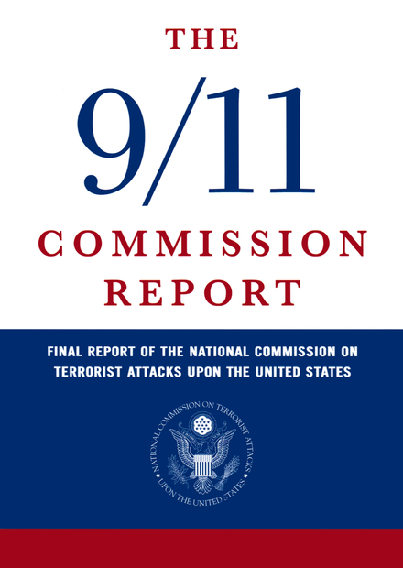
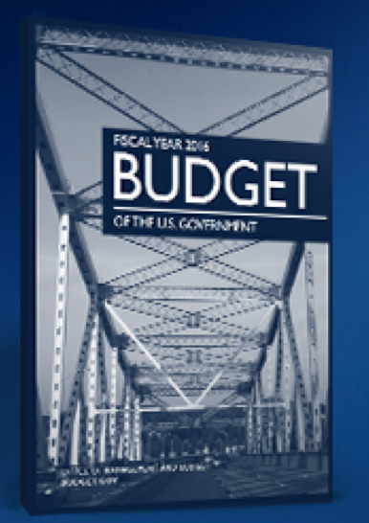
Govt public domain: Laws, official reports, hearings, studies, websites…

Slide 22
Unpublished works
Until recently, unpublished works had “common law copyright” that never expired
More recently, they have been current copyright terms (e.g. life+70 years)
  Applies to works never published or formally copyrighted before 2003
    (so as of 2015, authors who died before 1945)
  Works first published 1978-2003 remain in copyright until at least 2048

Slide 23
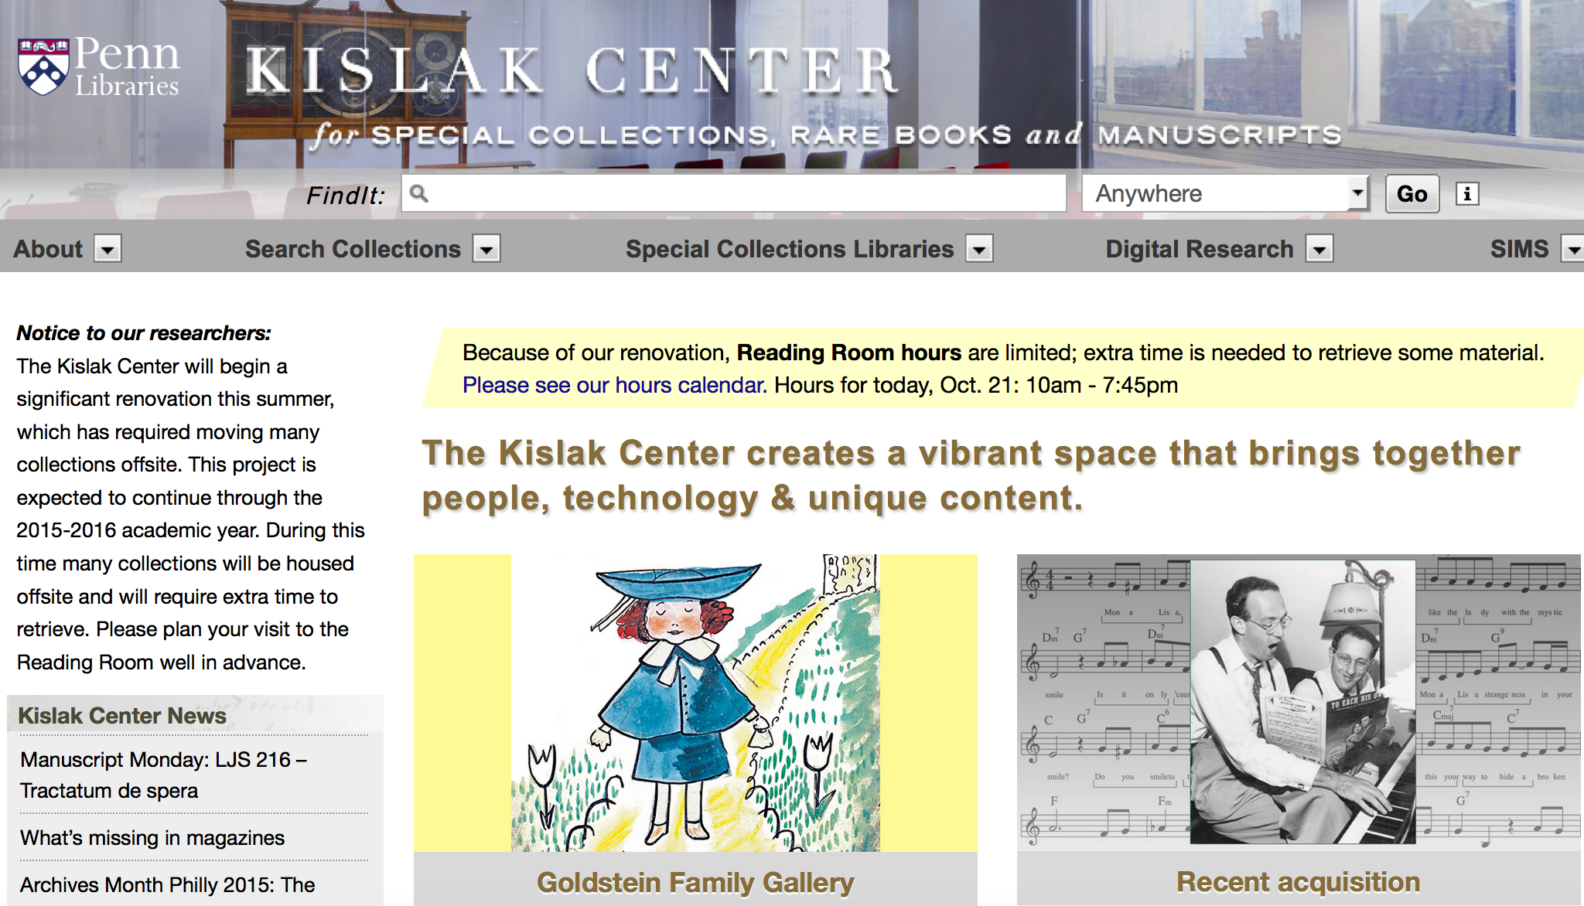
We have lots of unpublished works

Slide 24
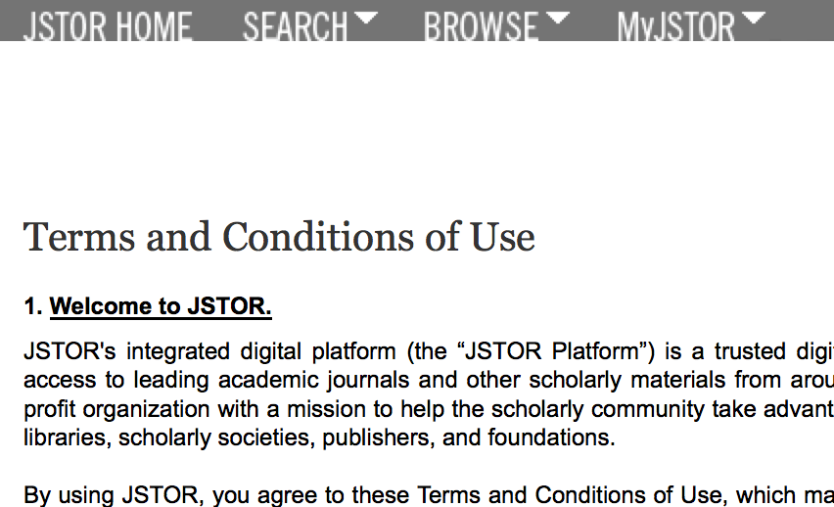
Caveat: Access to some public domain sources may be subject to contract

Slide 25
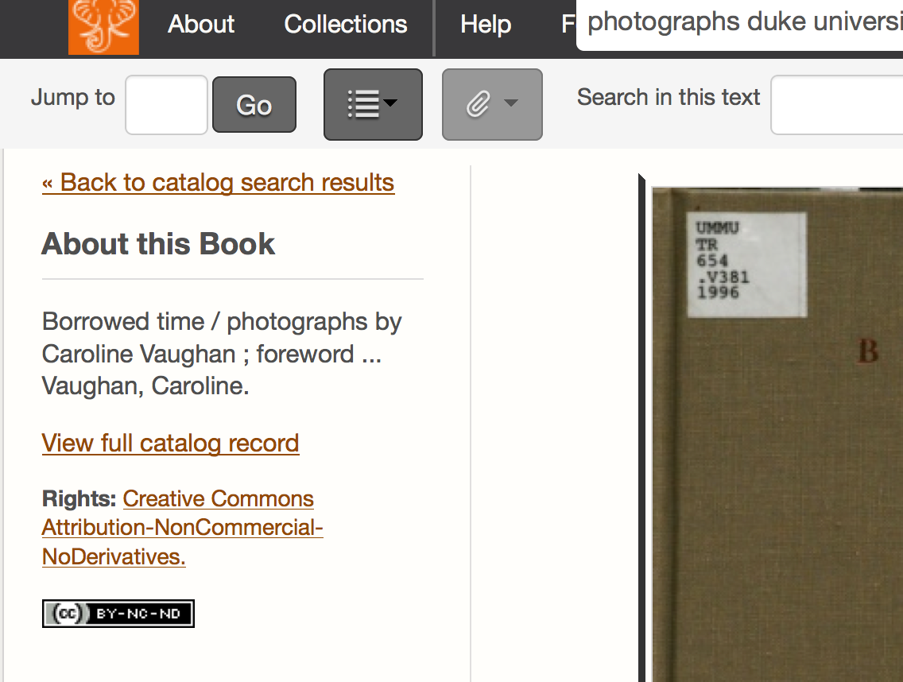
Caveat: Some HathiTrust material is open access but not public domain

Slide 26
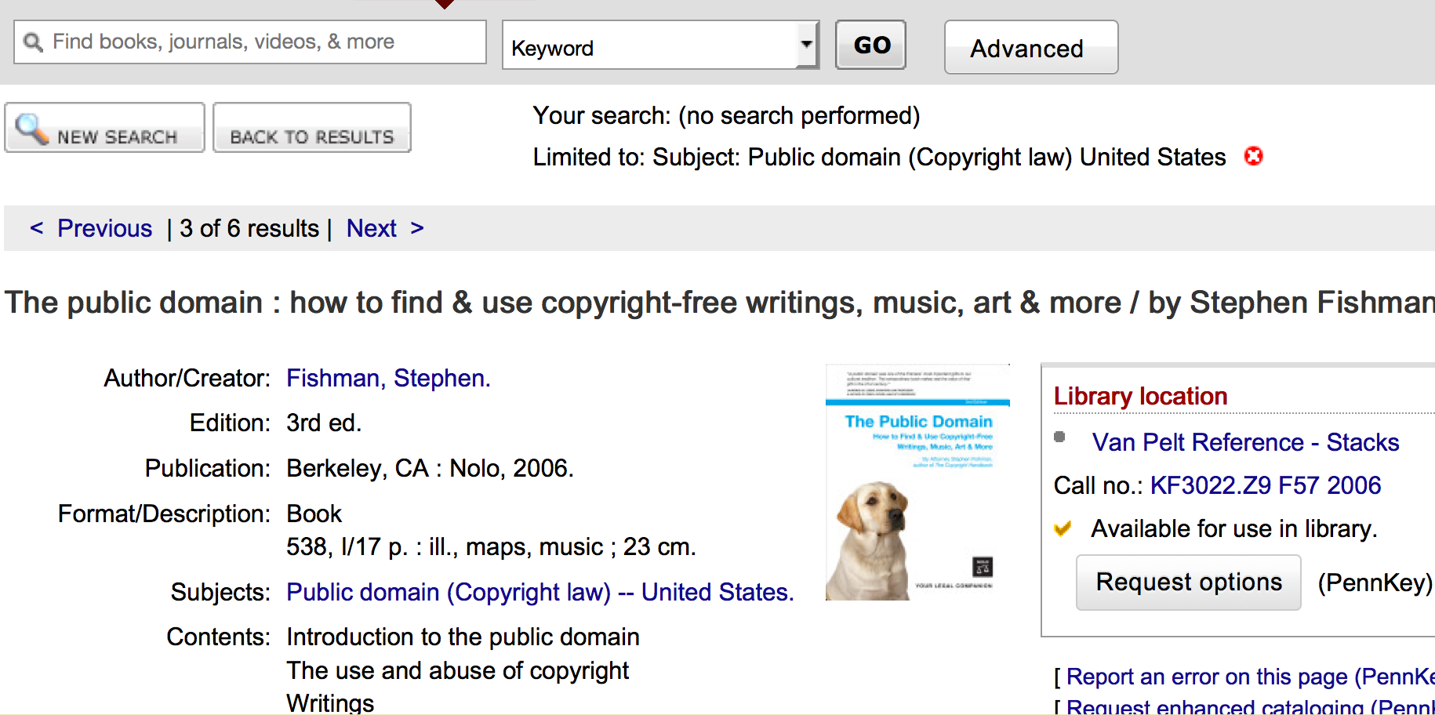
More info: See Fishman’s “The Public Domain”, and other library resources

Slide 27
Fair Use – Section 107
“Notwithstanding the provisions of section 106 and 106A, the fair use of a copyrighted work, including such use by reproduction in copies or phonorecords or by any other means specified by that section, for purposes such as criticism, comment, news reporting, teaching (including multiple copies for classroom use), scholarship, or research, is not an infringement of copyright.”

Slide 28
What’s fair? – the 4 factors
“In determining whether the use made of a work in any particular case is a fair use the factors to be considered shall include-”
the purpose and character of the use
the nature of the work
the amount used
the effect upon the market for the work

Slide 29
Takeaways
You can freely reuse a lot of material without having to get permission
  If you can determine it’s in the public domain
  Or if it’s copyrighted, but fair use or other exemption applies to your intended use
Penn Libraries have lots of public domain material
Penn librarians can help you research public domain status, answer copyright & reuse q’s
More info:
  http://guides.library.upenn.edu/copyright

